Slide 1


Sustainable Ireland
Tourism & Hospitality
May 2023
School of Hospitality Leadership

Slide 2
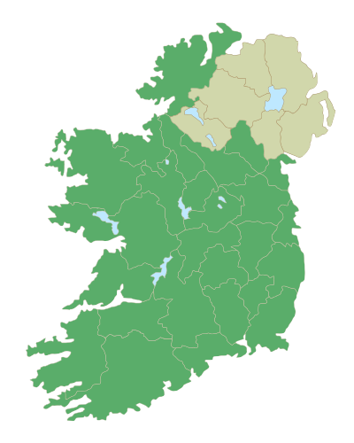
Dates:
May 8-19, 2023
Faculty
  Cynthia Deale, Ph.D.
  Robert O’Halloran, Ph.D.
School of Hospitality Leadership
Go to http://piratesabroad.ecu.edu/ and Summer Study Abroad Option

Slide 3
Sustainable Ireland
Join us to study sustainable hospitality and tourism in Ireland.
According to the United Nations Environment Programme and the World Tourism Organization, sustainable tourism can be defined as,
“Tourism that takes full account of its current and future economic, social and environmental impacts, addressing the needs of visitors, the industry, the environment and host communities."
Come with us in May 2023 to explore how Ireland embodies this form of responsible tourism that is good for the environment, good for the local community, and good for the tourist

Slide 4

Program Cost
Includes; accommodations in Ireland, bus transportation, some meals, tours and up to 6 credits. $3,720
Students are responsible for their own Airfare
Apply for: $1,000 scholarship from the College of Business available to SHL and other business students.
SHL students can apply for the Daly Scholarship: One student will receive the full amount of the SHL Program.

Slide 5
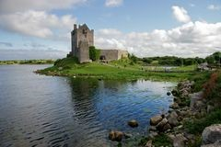
Undergraduate course selection; maximum of 6 credits
Summer Study Abroad Selections
HMGT 2170 - Hospitality Services Management
HMGT 3200 - Dimensions of Tourism
HMGT 4200 - Travel and Tourism Management
HMGT 4900 - Independent Study in Lodging
HMGT 4901 - Independent Study in Food and Beverage
HMGT 4902 - Independent Study in Conventions and Special Events
HMGT 4905 - Hospitality Management International Experience

Slide 6

Graduate course selection: maximum of 6 credits
HMGT 6310 - Strategic Management of Conventions and Special Events
HMGT 6400 - Critical Analysis of Food Service and Beverage Management Systems
HMGT 6410 - Strategic Management of Lodging Operations
HMGT 6420 - Current Issues and Strategies in Hospitality Management
SUTO 6000 - Principles of Tourism and Sustainability
SUTO 6200 - Development and Management of Sustainable Tourism
SUTO 6300 - Policy and Planning for Sustainable Tourism
SUTO 6600 - Study Abroad in International Sustainable Tourism and Management
SUTO 6610 - Sustainable Tourism Field Studies in Regional and National Settings
SUTO 6710 - Special Topics in Sustainable Tourism

Slide 7

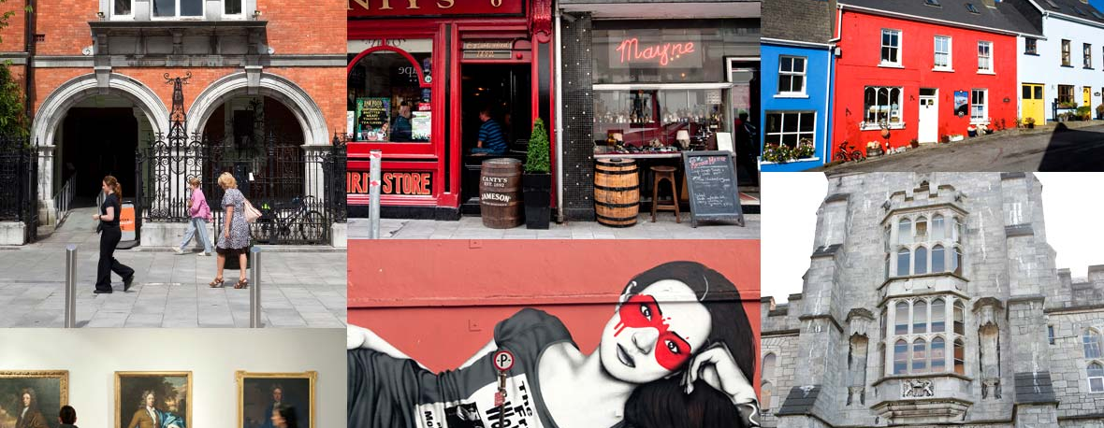



Cork

Slide 8

Killarney

Slide 9
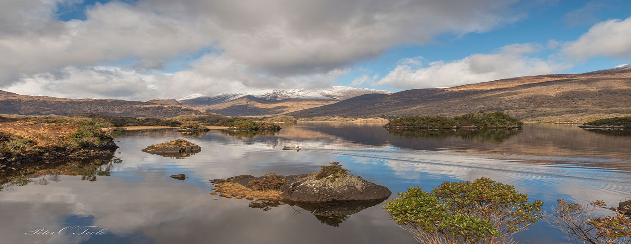
Killarney National Park

Slide 10
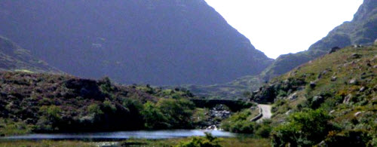
Rings of Kerry

Slide 11
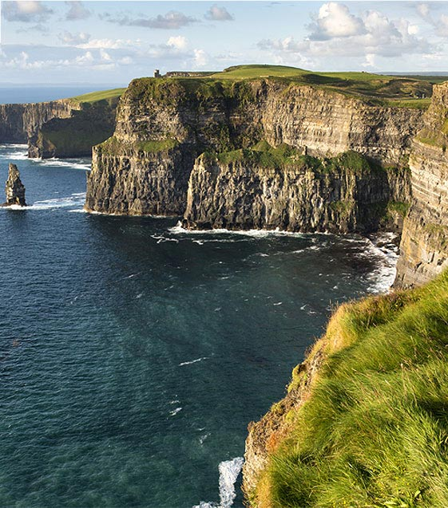
Cliffs of Moher

Slide 12

Dublin

Slide 13
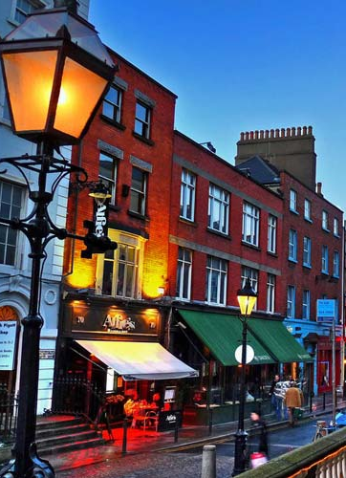
Dublin
Dublin
  Trinity College
  O’Connell St.
  Guinness Brewery/Storehouse

Slide 14
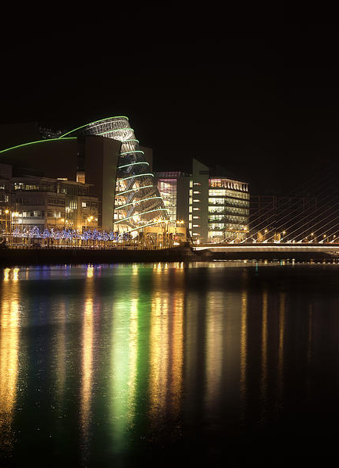
Return and depart from Dublin
Please make sure your passport has: ●
  No tears and at least six months of validity after return to the USA
  ● At least two empty pages for visas, more if visiting multiple countries
Don't forget to: ●
  Sign up for travel miles before you depart and make sure your miles are on your tickets ● Take a sweater for the flights
  ● Drink plenty of water on the flight and after you arrive

Slide 15

Questions?
Email us:
ohalloranc@ecu.edu
ohalloranr@ecu.edu

Slide 16
Pirates Abroad http://piratesabroad.ecu.edu/
https://business.ecu.edu/studyabroad/

